Slide 1

Smart Loans
Submitted By: Lydia Poulin
Course : MCA S6
ICET,Mulavoor
Project Guide: Sheena Jabbar

Slide 2
Abstract
The Smart Loan is an mobile application used for payment to the company to which we have to transfer the money. There are 2 users, customer and merchant. The app should be downloaded on both of the users.
The merchant contains modules like accept payment, transaction history, profile editing, log out etc. The customer contains registration of users or login, making payments , payment history, profile editing or view, log out etc.
The module make payment contains QR Code scan payments, wallet-to- wallet transfer. The payment history shows the details of the payments done to the customer.
Here, the payment is done by scanning the company’s QR code, not the products and the money is transferred directly to the merchants account. Reference application is: Paytm

Slide 3
Objective of the project
Used to make payment to the company to which money to be transferred.
Information retrieval will become easy.
Maintenance of database as well as overall project will become easy.
Security measure will be adopted by maintain the login of username and password.
Data redundancy will be greatly reduced
To reduce workload to staff.
To reduce the delay in processing time .
To reduce the delay in bill generation.
To provide the user friendliness in all possible ways.
To provide grater flexibility.
Make maintenance changes easy.
To store data in a centralized location to reduce redundancy and increase consistency.

Slide 4
Features
Make improvements to your bottom line.
Identify and categorize leads.
Increase referrals from existing customers.
Offer better customer support.
Improve products and services.
Work from anywhere.
Reduce costs.

Slide 5
Module description
Users
Merchant
contains modules like accept payment, transaction history, profile editing, log out etc
2. Customers
registration of users or login, making payments, payment history, transaction history, profile editing or view, log out etc.
Modules in Customer
1.Registration : In this section the new customers register to the system. They can access the application for payments. By using the mobile no and password they can login to the application .
2. Login :the user logged in to the application through this section. The registered user can login to the application directly using the mobile no and password.

Slide 6
3.Change password : here a existing password can be changed.
4.Forgot password : here a forgotten password can be changed by given a link.
5.QR Code scan payments : the payment is done by scanning the company’s QR code, not the products and the money is transferred directly to the merchants account.
6.Wallet-to- wallet transfer : the payment is done transferring from wallet to wallet.
7.Change security PIN : here a security code can be changed.
8.Payment history : shows the details of the payments done to the customer.
9. Transfer history : shows the details of the transactions done to the customer.
10. Profile editing or view : Views and Edit the details of the customers.
11.Logout: Logout section helps to logout from the application.

Slide 7
Technologies
Android
PHP
YII2
XAMPP(MYSQL)
GIT
POSTMAN

Slide 8
Android
Android is a mobile operating system developed by Google, based on a modified version of the Linux kernel and other open source software and designed primarily for touch screen mobile devices such as Smartphone and tablets.
This operating system is based on version 2.6 of Linux, so it has a monolithic system kernel, what means that all system functions and drivers are grouped into one block of code.
Linux kernel 2.6-which includes useful drivers that allow for example Wi-Fi or Bluetooth. The library written in C and C + + that provide higher level functionality such as an HTML engine, or a database (SQLite).
-A runtime environment for applications based on a virtual machine, made for inefficient machines such as telephones. The aim is to translate JAVA in machine language understood by Android. A JAVA framework that allows applications running on the virtual machine to organize and cooperate. The user applications written in Java (Web browser, contact manager etc. ..)
Today android is in its 5th version, Android 2.1. Each version is designed to gradually correct the lack of APIs, to enhance the user interface and add functionality. The latest version adds such things as support in HTML5 in the browser.

Slide 9
PHP
PHP: Hypertext Pre-processor (or simply PHP) is a server-side scripting language designed for web development but also used as a general-purpose programming language.
PHP originally stood for Personal Home Page ,but it now stands for the recursive acronym PHP: Hypertext Pre-processor.
PHP code may be embedded into HTML code, or it can be used in combination with various web template systems, web content management systems, and web frameworks. PHP code is usually processed by a PHP interpreter implemented as a module in the web server.
Any PHP code in a requested file is executed by the PHP runtime, usually to create dynamic web page content or dynamic images used on websites or elsewhere.

Slide 10
NETBEANS
Netbeans is an integrated development environment (IDE) for developing primarily with Java, but also with other languages, in particular PHP, C/C++, and HTML5.
It is also an application platform framework for Java desktop applications and others. The NetBeans IDE is written in Java and can run on Windows, OS X, Linux, Solaris and other platforms supporting a compatible JVM.
The Net Beans Platform allows applications to be developed from a set of modular software components called modules
Among the features of the platform are: User interface management (e.g. menus and toolbars) ,User settings management ,Storage management (saving and loading any kind of data) &Window management

Slide 11
YII2 Framework
Yii is an open source, object-oriented, component-based MVC PHP web application framework.
Yii is pronounced as "Yee" or [ji:] and in Chinese it means "simple and evolutionary" and it can be an acronym for "Yes It Is!“.
Yii features include:
Model-View-Controller (MVC) design pattern.
Internationalization and localization(I18N and L10N), comprising message translation, date and time formatting, number formatting, and interface localization.
Layered caching scheme, which supports data caching, page caching, fragment caching and dynamic content. The storage medium of caching can be changed.
Error handling and logging.

Slide 12
XAMPP
XAMPP is a free and open source cross-platform web server solution stack package developed by Apache Friends, consisting mainly of the Apache HTTP Server, Maria DB database, and interpreters for scripts written in the PHP and Perl programming languages.
XAMPP stands for Cross-Platform (X), Apache (A), MariaDB (M), PHP (P) and Perl (P). It is a simple, lightweight Apache distribution that makes it extremely easy for developers to create a local web server for testing and deployment purposes.
XAMPP is also cross-platform, which means it works equally well on Linux, Mac and Windows. Since most actual web server deployments use the same components as XAMPP, it makes transitioning from a local test server to a live server extremely easy as well.

Slide 13
My SQL
Structured Query Language (SQL), in computer science, a database sub language used in querying, updating and managing relational databases.
MY SQL Server is a relational database management system for distributed Client-Server computing.
Like all other database management systems, it provides the following features:
A variety of user interfaces
Physical data independence
Logical data independence
Query optimization
Data integrity
Concurrency control
Backup and recovery
Security and authorization

Slide 14
GIT
GIT is a version control system, a tool which is extremely smart choice to use even if it sounds over whelming, VCS is a group of files with monitored access.
GIT is a VCS developed by LINUX.
Its originally designed to help manage the LINUX Kernel and make collaboration easy from the beginning.
GITHUB is the most easy way to share project with collaborators.
Gits ﬂexibility and popularity make it a great choice for any team. Gits user community has created many resources to train developers and Gits popularity make it easy to get help when you need it.
Nearly every development environment has Git support and Git command line tools run on every major operating system.

Slide 15
POSTMAN
Postman makes API development faster, easier, and better.
The free app is used by more than 3.5 million developers and 30,000 companies worldwide.
Postman is designed with the developer in mind, and packed with features and options.
Postman features include:
Powerful
simple to use GUI Saved history of API requests Unlimited collections
Environments tests
sharing Automated testing with collection runner Web-viewable
detailed API documentation Flexible API monitoring for uptime
performance, and accuracy Mock servers, to support split-stack development .
Note on Permissions:
The “Your data on all websites” permission is required to send a request to a domain. It's not used for anything else by Postman.

Slide 16
Software Requirements
Front End Tool : HTML, JavaScript, CSS, Twitter Bootstrap, Android, Yii2
Back End Tool : PHP, MySQL
Development tools : Net Beans
Operating System : Windows XP 7 Professionals and Higher
Browse : Google Chrome. Mozilla Firefox
Hardware Requirements
Processors : Intel Premium Pro or Processor running at 133 MHz
Hard Disk : 1.2 GB Hard Disk
RAM : Client Level – Minimum 128MB
Recommended Requirements for peak performance
RAM : Client Level – Minimum 512MB
Display Type : SVGA Colour Enhanced Monitor
Mouse : PS/2 2 Button

Slide 17
Flowchart
Home
User
Registered user?
Signup
Login
Check user?
Admin
Merchant
Customer
Profile editing
Accept payment
Registration
Profile editing
Login
Transaction history
Transaction history
Making payments
Logout
Logout
Logout

Slide 18
UML-Use case Diagram
Register
user
visitor
Login
QR scan
Edit profile
Payment history
Registered user
Transfer history
Direct user
Make Payment
Wallet to wallet transfer
Change password
Set Security pin
Logout
Transaction gateway
3rd party system administration
Service provider

Slide 19
Activity diagram
Login/Register
Is user ?
Login
Register
Select service
QR scan
Payment History
Set security pin
Transfer history
Make Payment
Wallet to wallet transfer
Edit profile
Change password
Make another transaction ?
Logout

Slide 20
Table design
Tbl_user
Field name | Datatype | Size
Id | Id | 10
Username | Varchar | 20
Auth_key | Varchar | 10
Password_hash | Varchar | 10
Password_reset_token | Varchar | 10
Email | Varchar | 30
Status | Varchar | 20
Created_at | Varchar | 20
Updated_at | Varchar | 20
Device_token | Varchar | 20
Mob_no | Varchar | 20
User_role | Varchar | 20
Device_type | varchar | 20

Slide 21
Tbl_transaction
Field name | Datatype | Size
Trans_id | Id | 10
Pay_from | Varchar | 20
Pay_to | Varchar | 30
Amount | Varchar | 20
Description | Varchar | 20
Mode_payment | Varchar | 20
Tbl_transhistory
Field name | Datatype | Size
Transfer_id | Id | 10
Customer_id | Id | 10
Transfer_no | Varchar | 20
date | date | 20

Slide 22
Tbl_forgotpswd
Field name | Datatype | Size
id | Id | 10
email | varchar | 20
Tbl_changepswd
Field name | Datatype | Size
Change_id | Id | 10
Current_pswd | Varchar | 20
New_pswd | Varchar | 20
Confirm_pswd | varchar | 20

Slide 23
Tbl_pin
Field name | Datatype | Size
Pin_id | Id | 10
Current_pin | Varchar | 20
New_pin | Varchar | 20
Confirm_pin | varchar | 20
Tbl_scan
Field name | Datatype | Size
Scan_id | Id | 10
name | Varchar | 20
amount | varchar | 20

Slide 24
Tbl_editprofile
Field name | Datatype | Size
Id | Id | 10
Name | Varchar | 20
Email | Varchar | 20
Mob_no | Varchar | 20
address | varchar | 20
Tbl_migration
Field name | Datatype | Size
Id | Id | 10
Version | Varchar | 20
Apply_time | varchar | 20

Slide 25
Tbl_wallet2wallet
Field name | Datatype | Size
Id | Id | 10
UID | Id | 10
Amount | Varchar | 20
Description | Varchar | 20
Pin | varchar | 20
Tbl_payment
Field name | Datatype | Size
Payment_id | Id | 10
Customer_id | Id | 10
Payment_no | Varchar | 20
Date | Varchar | 20

Slide 26
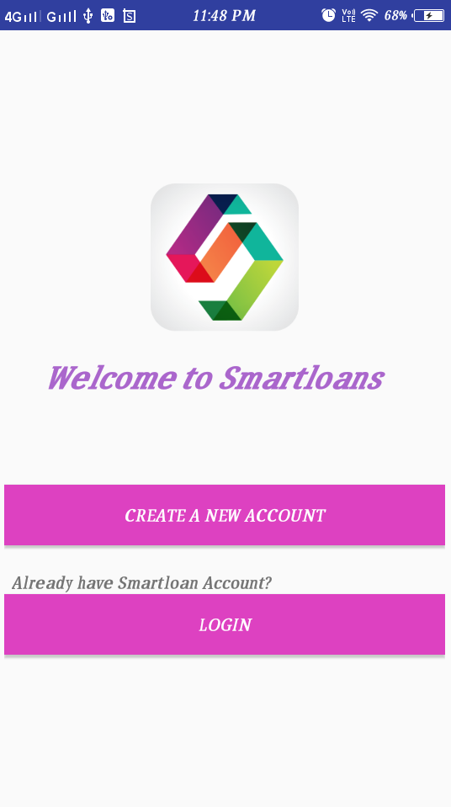
Screen Shots
Welcome page

Slide 27
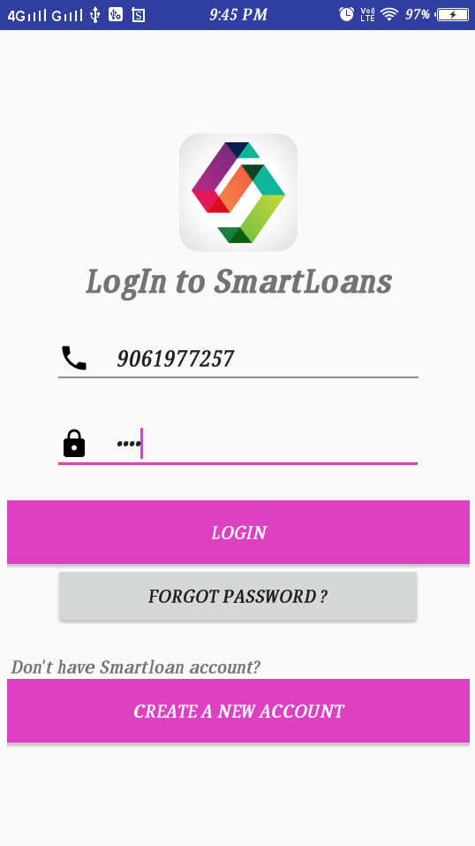
Login page

Slide 28
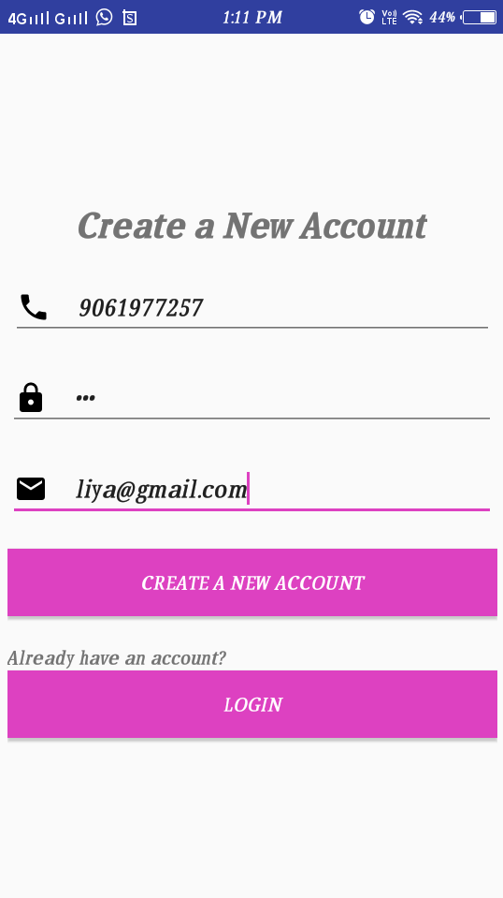
Registration page

Slide 29
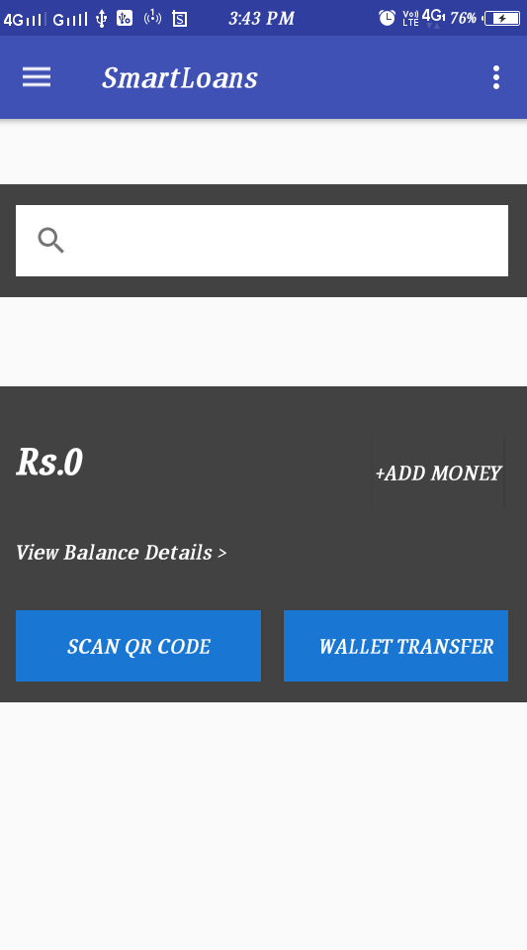
Home page

Slide 30
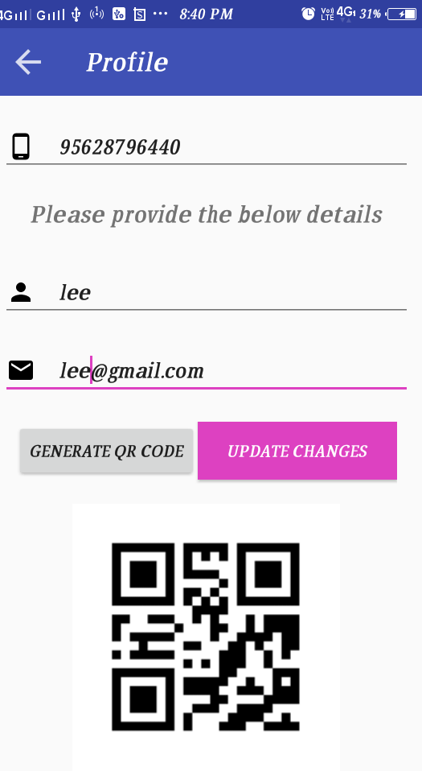
Edit profile

Slide 31
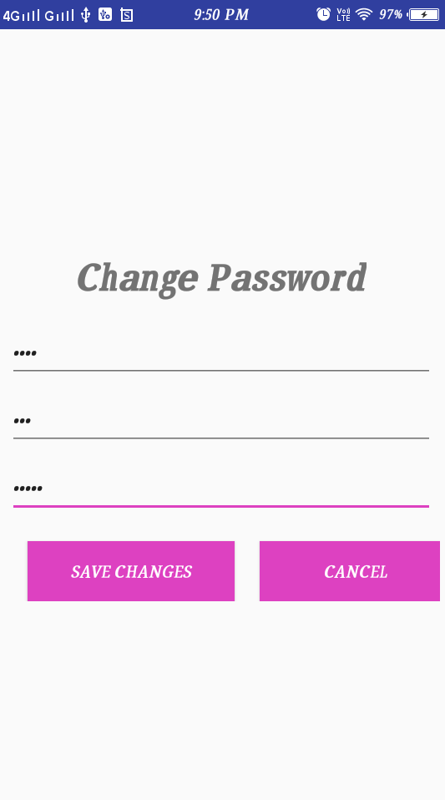
Change password page

Slide 32
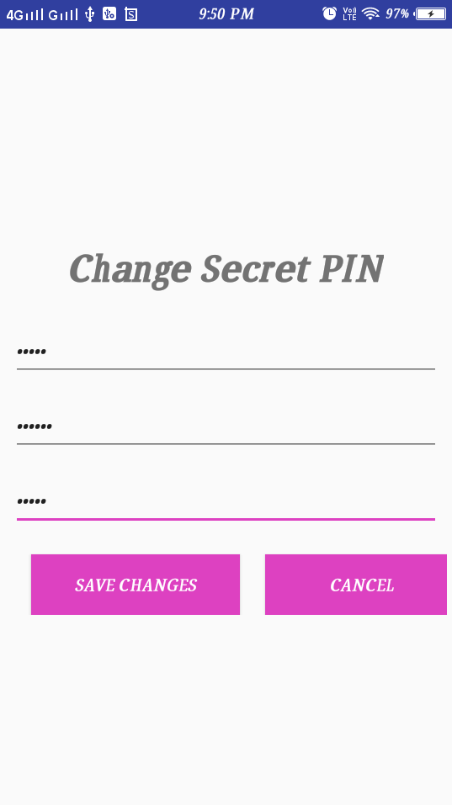
Change Secret PIN page

Slide 33
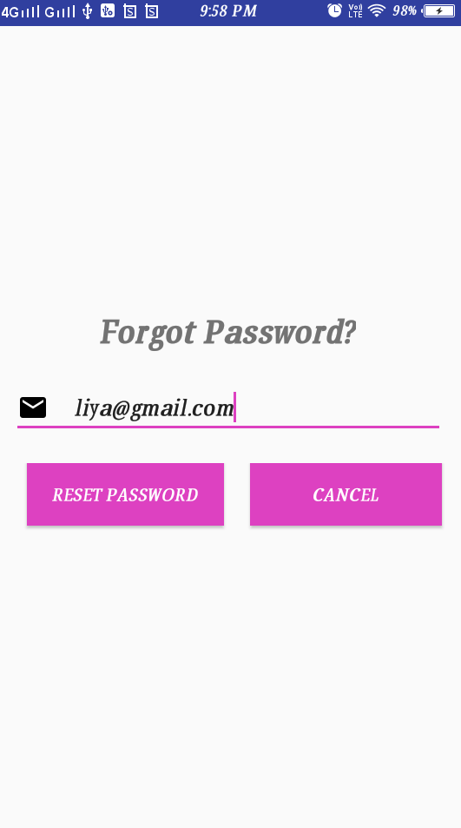
Forget password page

Slide 34
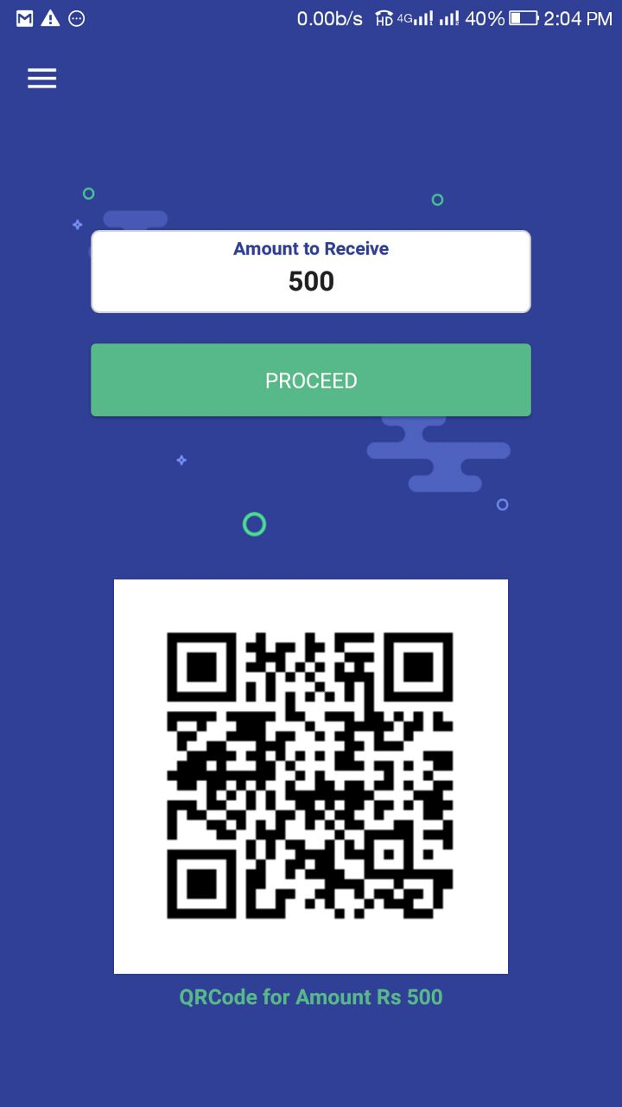
Transaction page

Slide 35
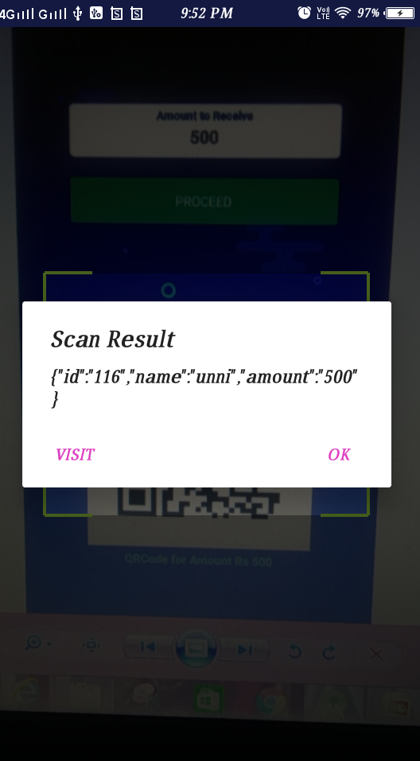
QR code Scan payment and Result page

Slide 36
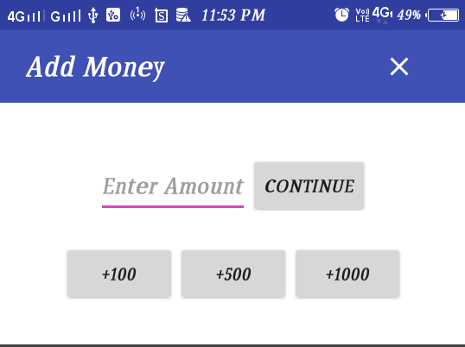
Addmoney

Slide 37
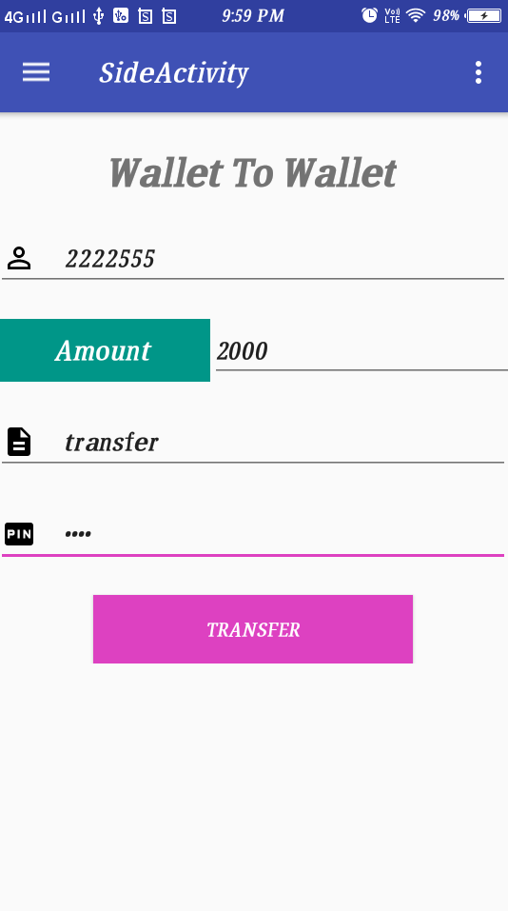
Wallet to wallet transfer
payment page

Slide 38
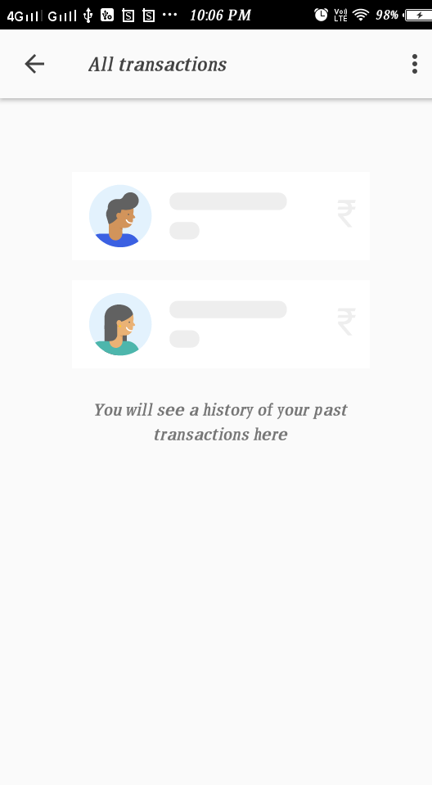
Payment & Transaction
history page

Slide 39
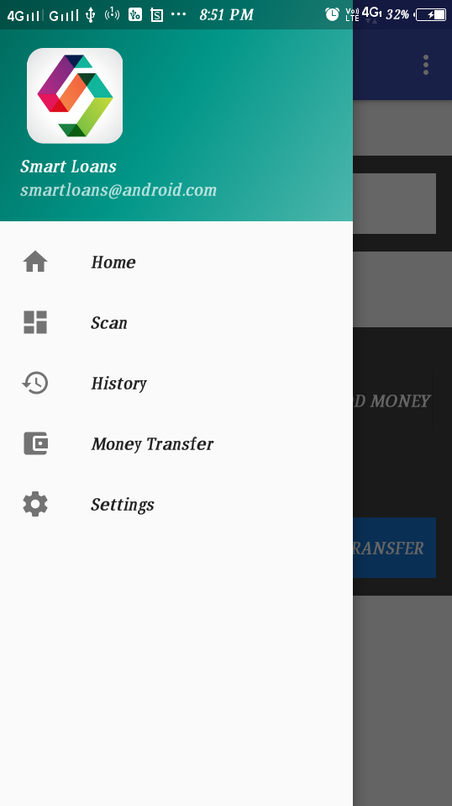
Side activity page

Slide 40
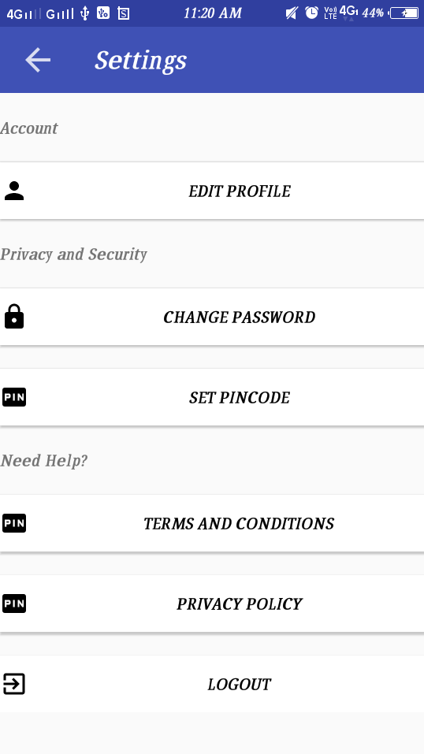
Settings Page

Slide 41
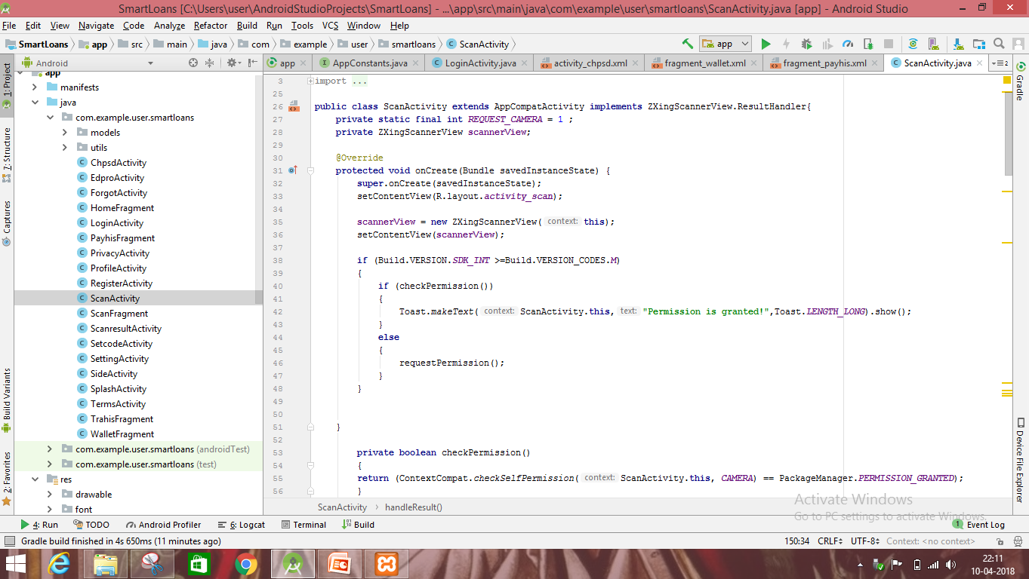
Coding
Scanactivity.java

Slide 42
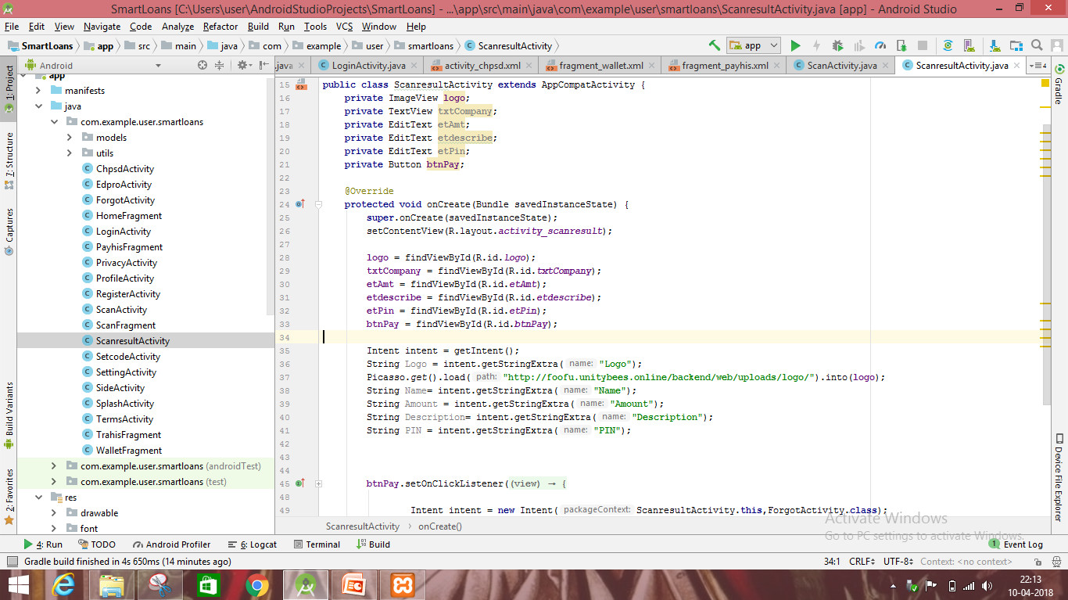
Scanresultactivity.java

Slide 43
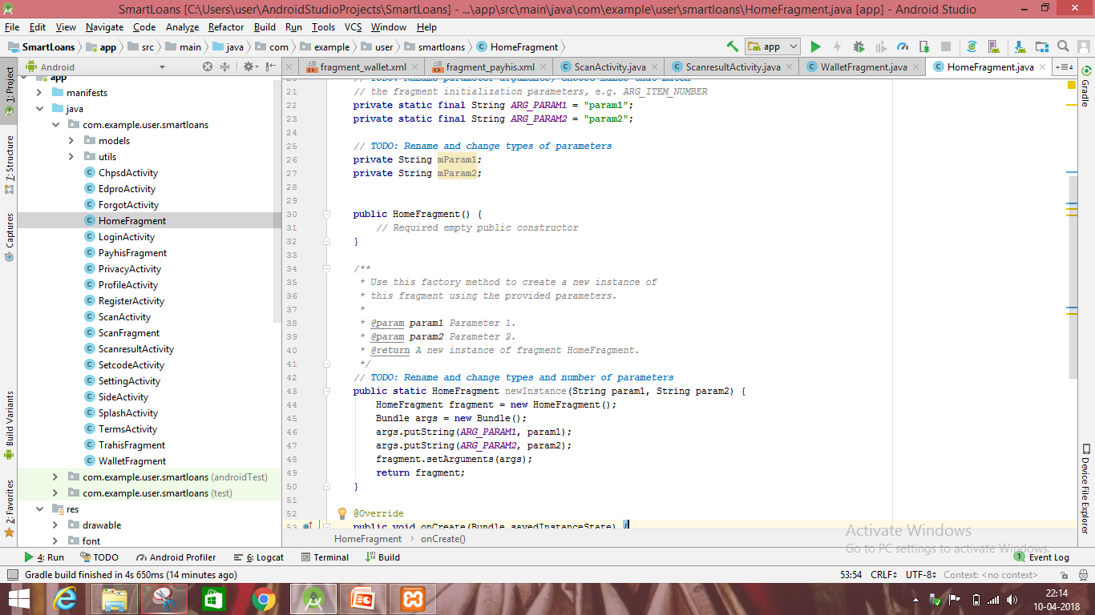
Homefragment .java

Slide 44


